Slide 1
Introduction to Data Science

Slide 2
Data Science Life Cycle
Business Problem Understanding
Data Collection
Data Cleaning
Data Exploration
Feature Engineering
Predictive Modeling/ Analytical Modeling
Visualization of Results

Slide 3
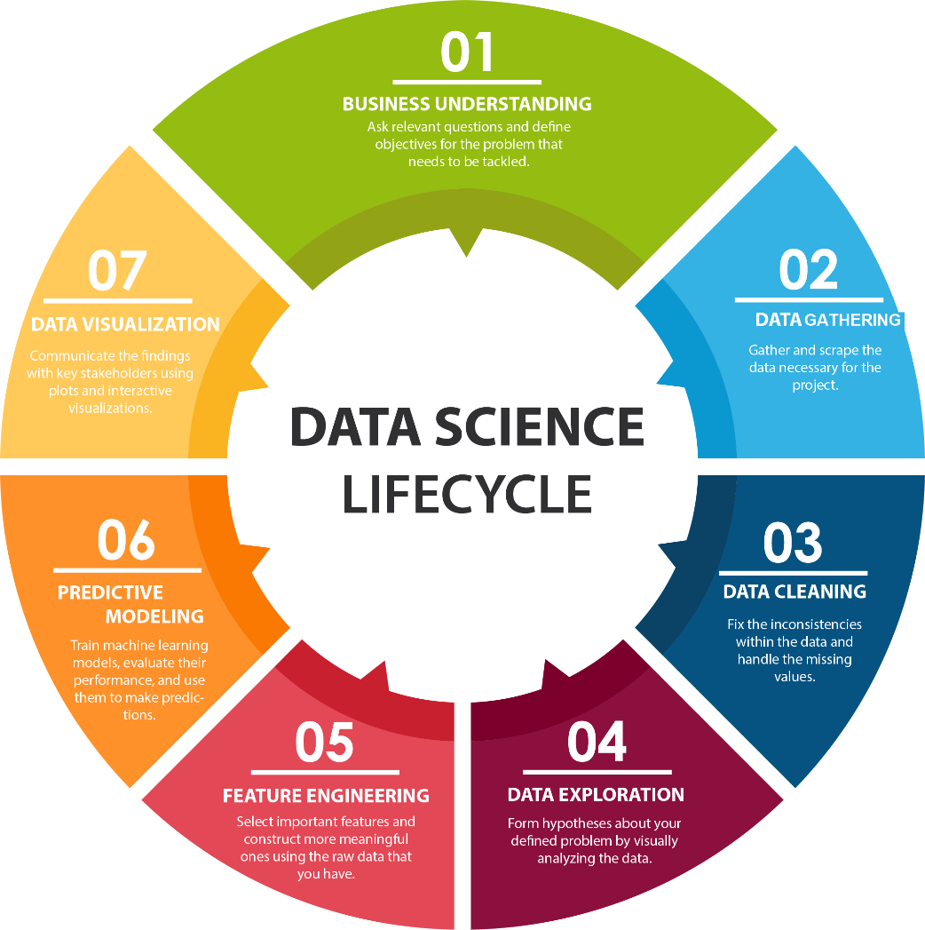

Slide 4
Data Science Life Cycle - II
Data science considers data at every stage of what is called the data lifecycle.
This lifecycle generally refers to everything from collecting data to analyzing it to sharing it so others can re-analyze it.
New visions of this process in particular focus on integrating every action that creates, analyzes, or otherwise touches data.
These same new visions treat the process as dynamic – archives are not just digital shoe boxes under the bed.
There are many representations of the this lifecycle.

Slide 5
Issues in Data Science
Finding The Right Data
Combining Data from Multiple Data Sources
Handling different and/or complex Data Formats
Dealing with Missing and Incorrect Data
Selecting Algorithm/Model/Tool to perform Data Analysis
Turn your analysis into actionable insights
Ensuring The Security Of Data and other Ethical issues

Slide 6
Applications of Data Science
Fraud and Risk Detection & Customer Segmentation in Banking
Image Analysis & Drug Development in Medicine
Internet Search & Targeted Online Advertising
Recommendations – Websites, Movies, Songs, TV Shows – ANY PRODUCT!
Speech Recognition
Airline Route Planning, Flight Delay Prediction, Logistics Management
Gaming

Slide 7
Applications of Data Science in Physics
Analyzing Aerodynamics or Hydrodynamics Models
Predictive Analytics for Soft-Body Physics – Wide-Motion-Range Joints Movement Prediction
Predicting Weather
Simulation, Analytics and Predictive Prevention of Natural & Man Made Disasters
Deriving results from the more than 20 petabytes of data generated for Particle Collisions in the Large Hadron Collider at CERN
Quantum Computing, Big Bang Modeling, Nuclear Explosion Simulations are some examples of applications of Data Science in Sub-Atomic Physics.

